Slide 1

Python programing
Anantharam A S

Slide 2
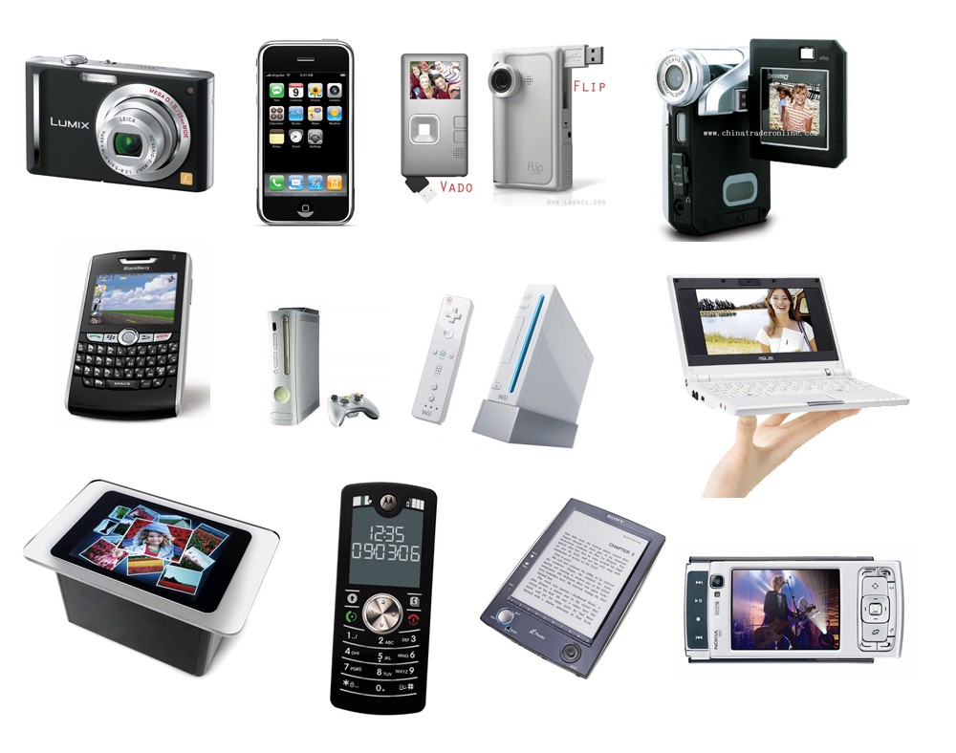
Computing devices

Slide 3
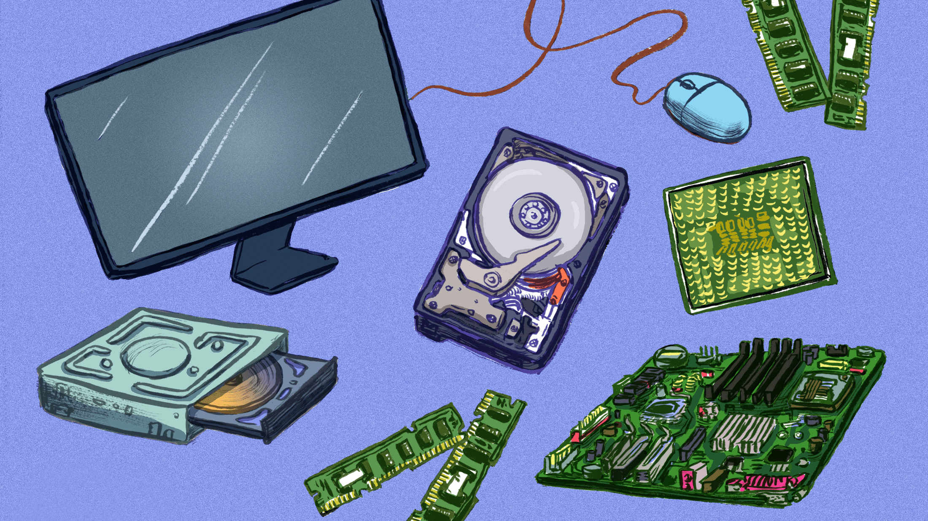






Software
Hardware
Operating System
Applications

Slide 4
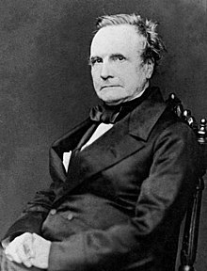
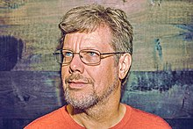
Father of Computers
Father of Python
Created in 1991 by Guido van Rossum

Slide 5
Variables and Data Types
Variables store and give names to data values
• Data values can be of various types:
• int : -5, 0, 1000000
• float : -2.0, 3.14159
• bool : True, False
• str : "Hello world!", "K3WL"
• list : [1, 2, 3, 4], ["Hello", "world!"], [1, 2, "Hello"], [ ]
• And many more!
In Python, variables do not have types!
• Data values are assigned to variables using "="
20
Variables and Data Types
x = 1 # this is a Python comment
x = x + 5
y = "Python" + " is " + "cool!"

Slide 6
Variables and Data Types in Real Life

Slide 7
Type Casting
int() - to convert an integer literal, a float literal (by removing all decimals), or a string literal (providing the string represents a whole number) to integer
float() - to convert an integer literal, a float literal or a string literal (providing the string represents a float or an integer) to float
str() - to convert a wide variety of data types, including strings, integer literals and float literals ro string
x = int(1) # x will be 1 y = int(2.8) # y will be 2 z = int("3") # z will be 3
x = float(1) # x will be 1.0 y = float(2.8) # y will be 2.8 z = float("3") # z will be 3.0 w = float("4.2") # w will be 4.2
x = str("s1") # x will be 's1’ y = str(2) # y will be '2’ z = str(3.0) # z will be '3.0'

Slide 8
Go to Store
Go to Store
Go to fruit section
Go to fruit section
Banana
Exists?
Buy 1kg banana
True
Come back home
False
Buy 1kg banana
Come back Home

Slide 9
Which is the best subject?
Is it “Computer Science”
Try again
False
True
Come back Home

Slide 10
Conditions
Cores of programming! Used to write logic.
Ambiguity ?
Rely on boolean expressions which return either True or False
1 < 2 : True
1.5 >= 2.5 : False
answer == "Computer Science" : can be True or False depending on the value of variable answer
Boolean expressions can be combined with : and, or, not
1 < 2 and 3 < 4 : True
1.5 >= 2.5 or 2 == 2 : True
not 1.5 >= 2.5 : True

Slide 11
Conditions
Real life conditions
If I score 90% dad will gift me Iphone
If temperate is above 99F then I have fever
If I reach from school before 5PM I will go to skating

Slide 12
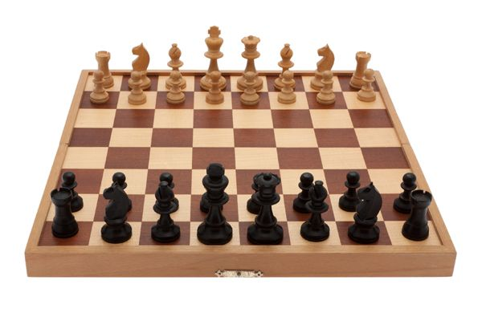

Slide 13
Conditionals: Generic Form
Conditionals: Generic Form
if boolean-expression-1:
code-block-1
elif boolean-expression-2:
code-block-2
(as many elif's as you want)
else:
code-block-last

Slide 14
Loops

Slide 15
Loops
Which is the best subject?
Useful for repeating code!
Two variants:
while boolean-expression:
code-block
Is it “Computer Science”
Try again
False
True
Of course it is!

Slide 16
While loops
while raw_input("Which is the best subject? ") != "Computer Science":
print("Try again!")
print("Of course it is!")

Slide 17
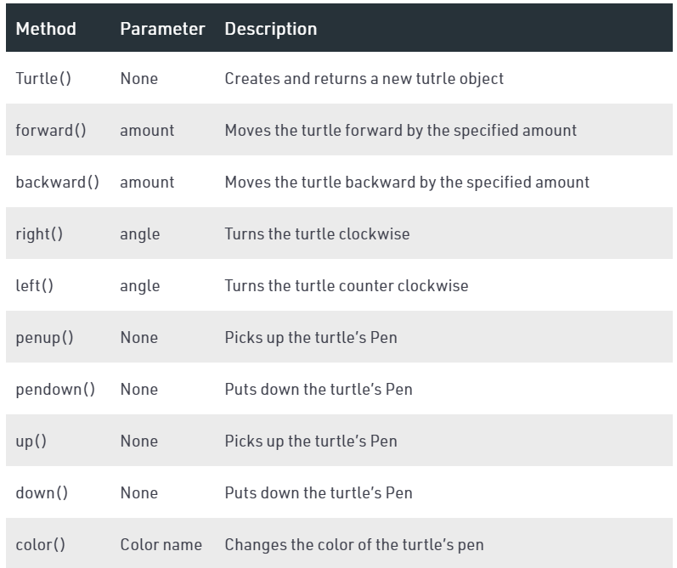
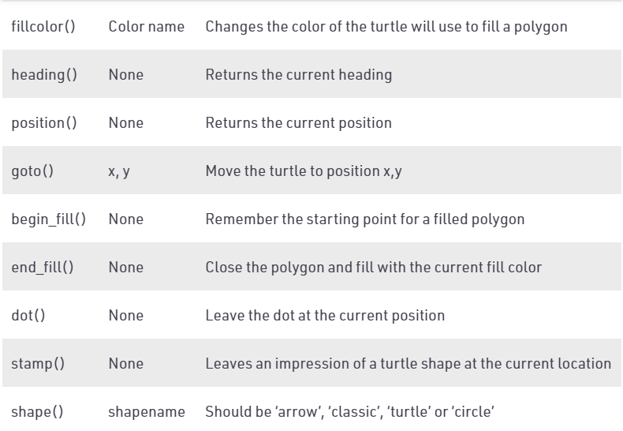

Slide 18

Monitor screen
Pixels

Slide 19
Digital display
1
6
2
7
5
3
4

Slide 20
Digital display
1
6
2
7
5
3
4

Slide 21
Digital display
1
6
2
7
5
3
4

Slide 22
Digital display
1
6
2
7
5
3
4

Slide 23
Assignment

